Slide 1
Using cardiovascular features to classify state changes during cooperation in a simulated bomb defusal task
Mark Dennison
PhD Candidate, UC Irvine Intern, US Army Research Lab West
mdenniso@uci.edu
PAVA 2016

Slide 2
Importance of state information
Psychological (e.g. challenge, threat) and physiological (e.g. fatigue) states can have dramatic effects on human performance and resilience both in training and in the field
Access to this information may allow systems to make better decisions about users
Training can be optimized to the individual or team and adapted in real time according to state changes to maximize learning (e.g. behavior of a virtual bomb defusal coach)

Slide 3
Importance of state information
Psychological (e.g. challenge, threat) and physiological (e.g. fatigue) states can have dramatic effects on human performance and resilience both in training and in the field
Access to this information may allow systems to make better decisions about users
Training can be optimized to the individual or team and adapted in real time according to state changes to maximize learning (e.g. behavior of a virtual bomb defusal coach)
Problem: Traditional methods, such as questionnaires, can be too cumbersome to deploy online and do not provide critical information immediately
Solution: Automatic behavior analysis, tracking, and machine learning can enable novel approaches to assess dynamic behavior of individuals and teams

Slide 4
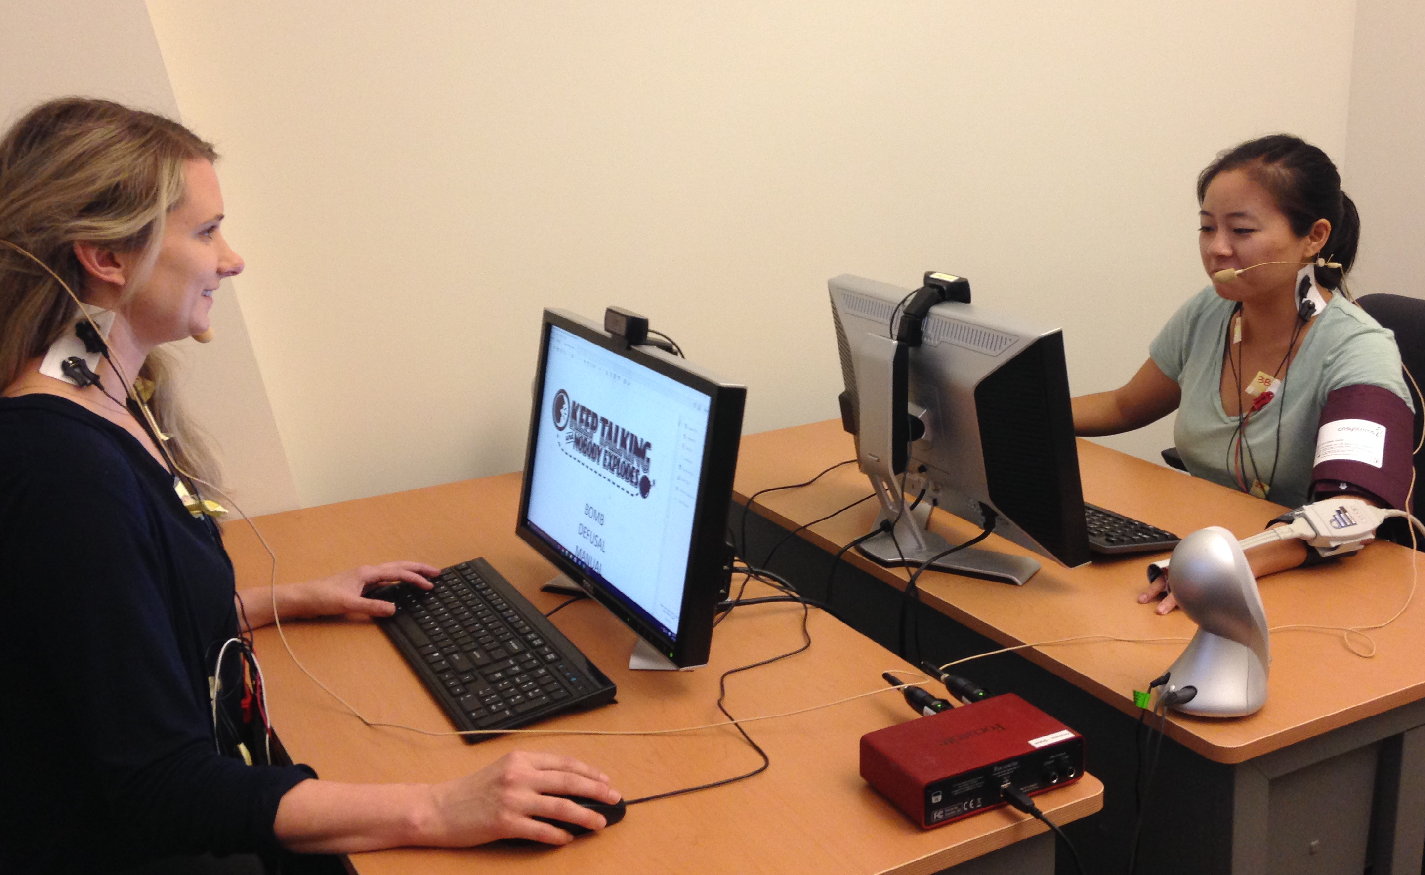
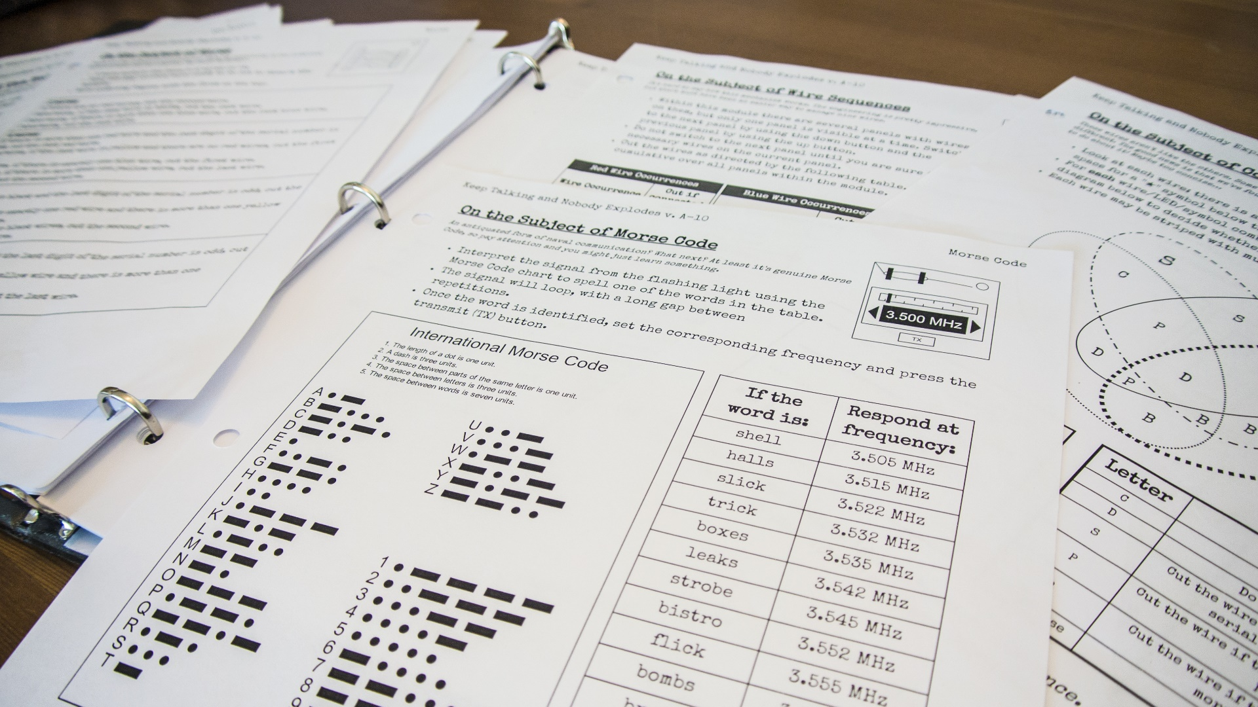
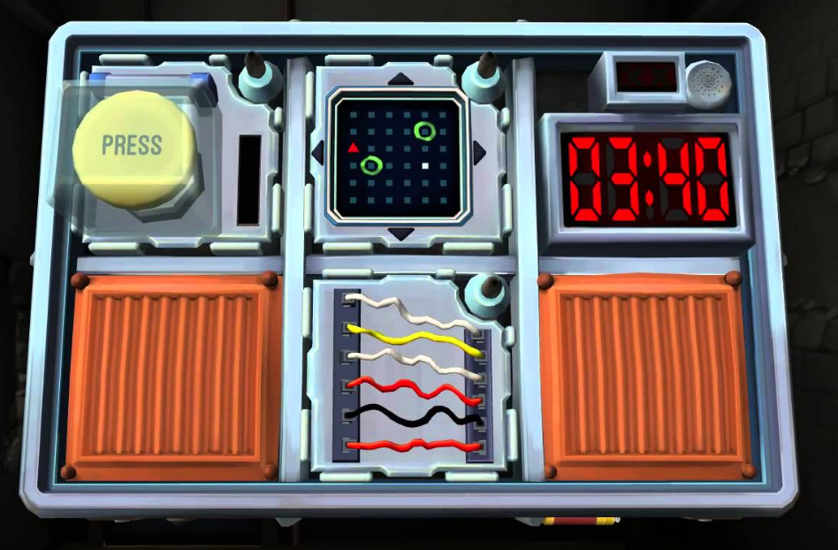
Simulated bomb defusal
Data were collected by collaborator Dr. Cathy Neubauer from USC’s Institute for Creative Technologies
Teams of two individuals had to work together to defuse a bomb within approximately 5 minutes
One team member examined the defusal manual to discover how to properly disable each bomb module
The other team member interacted with the virtual bomb as instructed by their partner

Slide 5
Primary manipulation
Half of the subject teams were given time to converse with their teammate as an Icebreaker (IB) before the task
The other half of the subjects served as Controls (CT) and did not converse with one another before the task

Slide 6
Research Questions:
RQ1: Do subjects in the Icebreaker group show cardiac changes that are characteristic of a challenge state or a threat state?
RQ2: Can we classify which experimental group a subject came from using only cardiac data?

Slide 7
Physiological data preparation
Split raw time series into shorter segments of 30 seconds
Extract cardiac features using Moving Ensemble Average Program (MEAP) ¹
MEAP is part of a collaboration with UCSB’s Institute for Collaborative Biotechnologies
Transform features as percent change from the average of the last 60s of baseline data
Focus on changes in the final 30 seconds when the task is the most intense and team cohesion is critical for success
1) Matthew Cieslak 2016

Slide 8
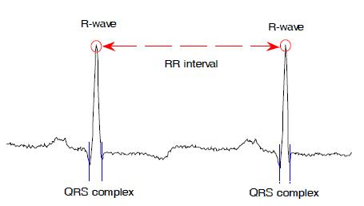
Ensemble Averaging
Similar to ERP analysis in EEG research
Align averaging window to the R-peak of the heart beat instead of an experimental event
Window size affects feature quality and limits speed of “real time” feedback

Slide 9
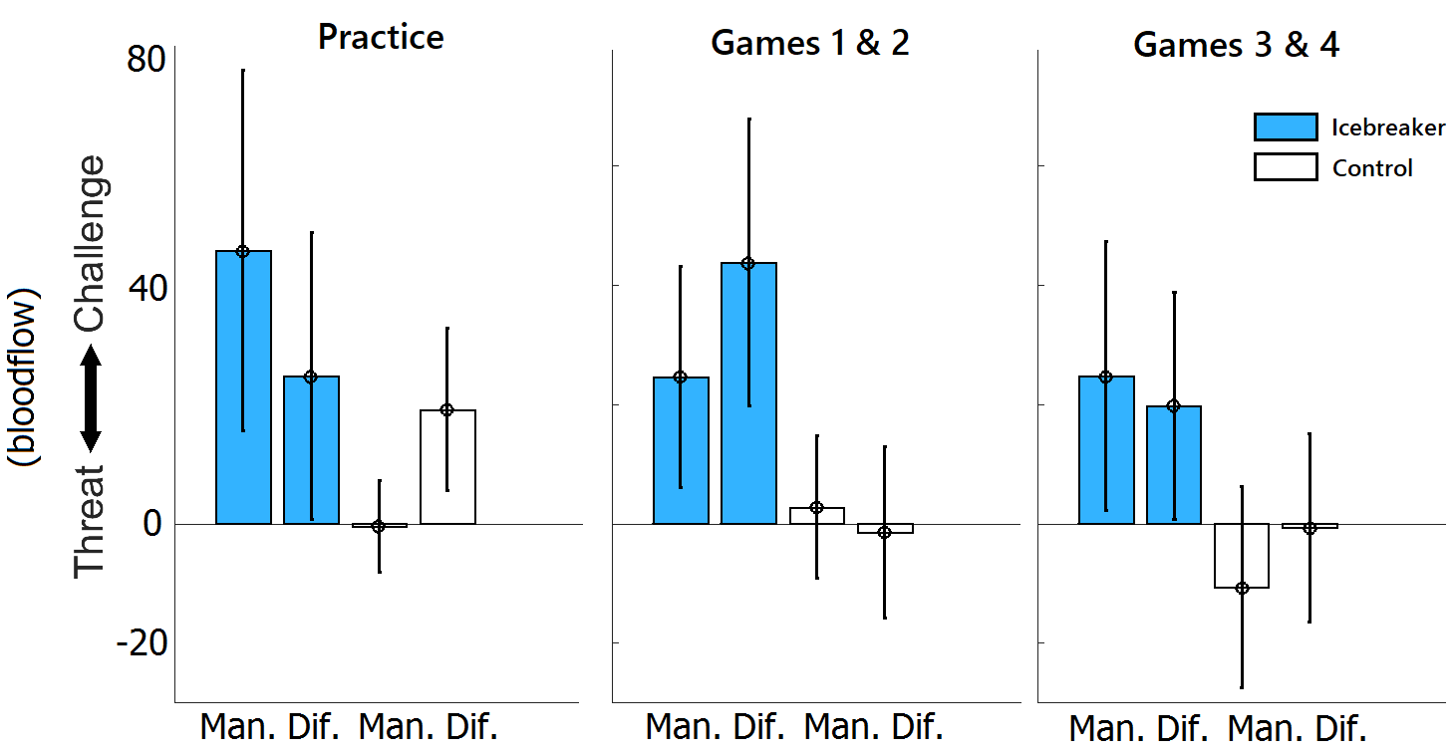
RQ1: IB Groups trend to show a challenge state
According to the BioPsychoSocial ^{2,3} model of challenge and threat:
Challenge: resources exceed demands, increase in blood flow
Threat: demands exceed resources, decrease in blood flow
Increased blood flow is important for proper function of peripheral appendages and the brain
Data show trend that Ice Breaker participants exhibit a greater challenge response than Controls
2) Blascovich 2008 3) Blascovich & Tomaka 1996

Slide 10
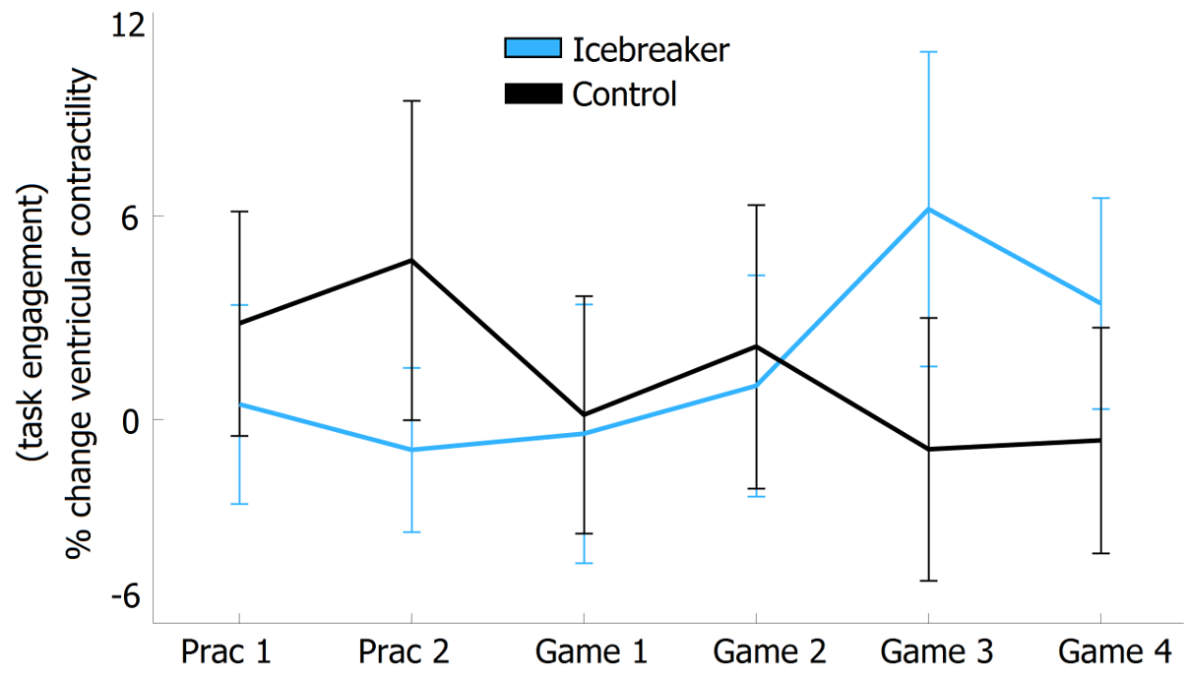
Task engagement changes with time depending on group
Ventricular contractility (VC) has been shown to be related to task engagement ⁴
VC increases significantly over time for IB subjects and decreases for CT subjects
Demonstrates conflict with self-reported engagement on the Dundee Stress State Questionnaire
F(5,170) = 2.6, p = .027, η² = .071
4) Blascovich et al. 2011

Slide 11
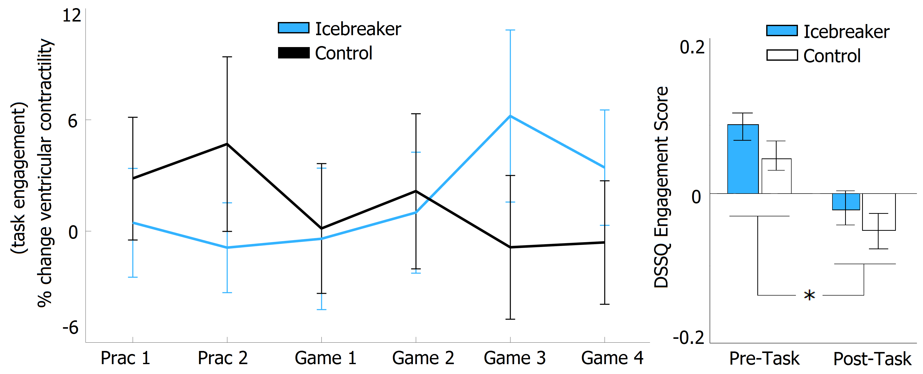
Physio data conflict with task engagement survey
Survey data from this study shows subjects felt more disengaged at the end of the entire experiment ⁵
Shows VC may be a useful tool to automatically and covertly track changes in engagement over a shorter time scale
5) Neubauer et al. (in press)

Slide 12
RQ2: Cardiac features can be used to classify condition
Objective:
use cardiovascular features to classify subjects as belonging to the Control or Ice Breaker condition in their first game
Features included:
Pre-ejection period, cardiac output, total peripheral resistance, heart rate, stroke volume, and mean arterial pressure
Leave-one-out Cross Validation
Train model on 17 subjects, test on 18th subject
Repeat this for all subjects and take the average performance across iterations

Slide 13
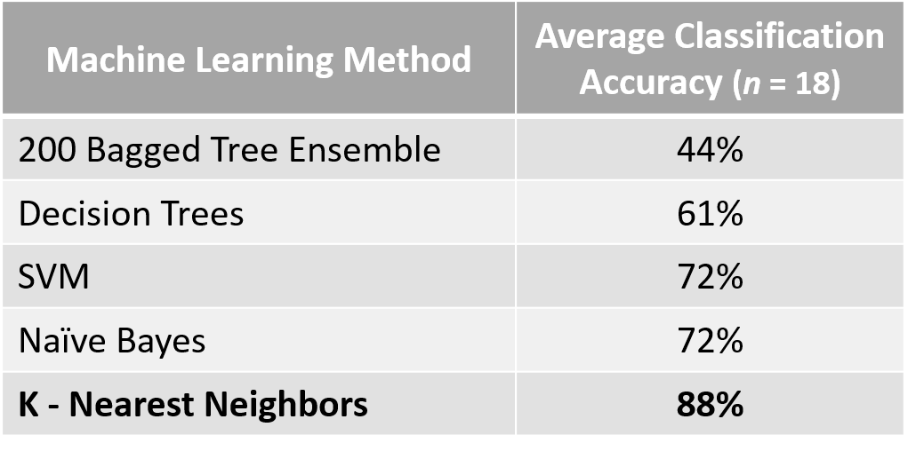
RQ2: Cardiac features can be used to classify condition
(k = 2)
Performing PCA before training resulted in a performance loss of at least 10% in all models

Slide 14
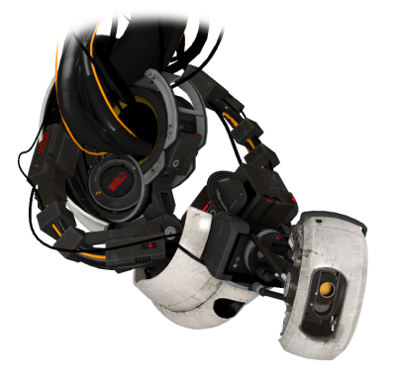
Applications to PAVAs
Learning can be especially difficult during stressful tasks
Trainees will benefit from systems that are able to understand their emotions and adapt task parameters accordingly
Inclusion of a PAVA during bomb defusal can provide appropriate feedback based on analysis of players’ cardiovascular data
Provide encouragement when player’s are in a threat state or give dialogue to increase engagement when VC is lower than baseline
More work needed to incorporate additional multimodal signals and to make analyses near-real time
“Fantastic! You remained resolute and resourceful in an atmosphere of extreme pessimism."

Slide 15
Collaborators
Peter Khooshabeh – ARLW HRED
Andre Harrison – ARL CISD
Tony Passaro – ARLW HRED
Cathy Neubauer – USC ICT
Stefan Scherer – USC ICT

Slide 16
Thank you!
Questions?

